Slide 1
INTERNET AND
WORLD WIDE WEB
TECHNOLOGIES
Copyright © 2005 Prentice Hall, Inc.
6-<number>

Slide 2
LEARNING GOALS
Describe the Internet’s current architecture.
Identify and describe the major Internet applications.
Define the World Wide Web and its structure.
Understand how Internet and World Wide Web searches work.
Describe how the Internet is governed.
Define intranets and extranets and explain how companies use them.
Copyright © 2005 Prentice Hall, Inc.
6-<number>

Slide 3
Internet and WWW at the Bead Bar
Leased lines to connect Bead Bar Headquarters with each studio would cost more than $1,000 per month.
Meredith believes that the Bead Bar should have a Web page. Some of the uses for the web site might be:
  Sell jewelry
  Promotion of studios
  Communicate with franchises
  Help establish brand name
Suzanne wants high-speed connections to studios
Mitch wants to be able to search the WWW for information on the cruise industry.
Julia is concerned about the controlling the costs
Rachel wants to process franchise purchase requests using an intranet to improve response time.
Copyright © 2005 Prentice Hall, Inc.
6-<number>

Slide 4
Internet Architecture
A Brief History of the Internet – written by some of the people who were there at the start
Hobbes' Internet Timeline v7.0
Today’s Internet
  Thousands of networks
  Connected by legal agreements and commercial contracts
  Uses TCP/IP protocol
  Internet service providers (ISPs)
    Provide most individual users with access to the Internet
    Dialup connections
    Modems and conventional phone lines
    xDSL and cable modems provide broadband access
Copyright © 2005 Prentice Hall, Inc.
6-<number>

Slide 5
Accessing the Internet Backbone
Much of the Internet traffic occurs among multiple ISPs
Network Access Points (NAPs)
  High-speed routers route traffic between ISPs and the Internet backbone
  Backbone – fiber optic connections owned and operated by large telecommunications companies
    UUNet’s North America Internet network
Copyright © 2005 Prentice Hall, Inc.
6-<number>

Slide 6
TCP/IP
Communications protocol suite
  Packet switched protocol
    No end-to-end connection is required
    Each message broken down into small pieces called packets
    Packets possibly routed to destination over different paths
  Transmission Control Protocol (TCP)
    Breaks messages into packets
    Numbers packets in order
    Reorders packets at the destination
  Internet Protocol (IP)
    Routes packets to the proper destination
Copyright © 2005 Prentice Hall, Inc.
6-<number>

Slide 7
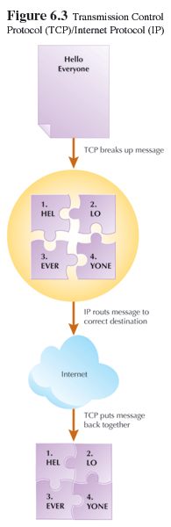
Copyright © 2005 Prentice Hall, Inc.
6-<number>

Slide 8
Domain Names
Every computer connected to the Internet must have a unique IP address
  IP address format is xxx.xxx.xxx.xxx where xxx is a number between 0 and 255
How do we know that 207.46.245.222 is Microsoft?
Domain Name System (DNS)
  A database of Internet names
  DNS Servers convert Internet names to IP addresses
  Top level domains
Copyright © 2005 Prentice Hall, Inc.
6-<number>

Slide 9
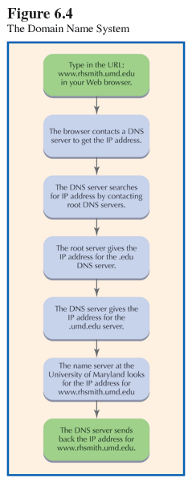
Copyright © 2005 Prentice Hall, Inc.
6-<number>

Slide 10
Internet Applications
E-Mail
File transfers
Instant messaging (IM)
Newsgroups
Streaming audio and video
Internet telephony
World Wide Web (WWW)
Copyright © 2005 Prentice Hall, Inc.
6-<number>

Slide 11
E-Mail
Most popular and widely used Internet application
30 billion e-mails sent every day
  Spam – junk e-mail messages
  Spam costs corporate America $9 billion per year
Every e-mail message contains head that describes source and destination for the message
E-mail messages are text, but may have attachments of many types of digital data
  Viruses often transmitted via e-mail
Copyright © 2005 Prentice Hall, Inc.
6-<number>

Slide 12
File Transfers
File transfer protocol (FTP)
  Protocol providing for transmission of a file between an Internet server and a user’s computer
Peer-to-peer (P2P) file sharing
  Share data from one computer to another
  Every user can be a server
  Napster
    Kazaa
    Gnutella
  With P2P, every user on the network can make data available to every other user on the network
Copyright © 2005 Prentice Hall, Inc.
6-<number>

Slide 13
Instant Messaging
Allows user to create a private chat session with another user
IM started with AOL
IM sneaking into corporate networks
Many Web-based companies use IM technology for customer service
  State of Virginia
  eBay
Copyright © 2005 Prentice Hall, Inc.
6-<number>

Slide 14
Usenet Newsgroups
Online, bulletin board discussion forums
Users post and read messages
More than 100,000 newsgroups
Millions of newsgroup readers
Important information resource, especially for technical issues and products
Newsgroup messages distributed using open standard
  Many are uncensored
Copyright © 2005 Prentice Hall, Inc.
6-<number>

Slide 15
Streaming Audio and Video
Creating and sending audio and video files
  Sports
    Men’s intercollegiate basketball at sports.yahoo.com
    Major league baseball
  News
    Fox News
    CNN radio
  Business
    ZDNet
  Education
    Warriors of the Net
Copyright © 2005 Prentice Hall, Inc.
6-<number>

Slide 16
Internet Telephony
Voice-over Internet Protocol (VoIP)
Use your computer like a telephone
Software connects computers via the Internet and transmits voice data
Savings comes from eliminating toll charges between locations
Copyright © 2005 Prentice Hall, Inc.
6-<number>

Slide 17
The World Wide Web
Collection of hyperlinked computer files on the Internet
Client-server application
  Web servers
  Web browsers as clients
WWW standards
  Hypertext markup language (HTML)
    Current standard for writing Web pages
    Implementation of SGML specifically for Web pages
    Tags in HTML instruct the client browser how to format and display the Web page content
  Hypertext transfer protocol (HTTP)
    Protocol that establishes a connection between Web server and client
  Extensible markup language (XML)
    A meta-markup language
    Gives meaning to the data enclosed within XML tags
Copyright © 2005 Prentice Hall, Inc.
6-<number>

Slide 18
Static versus Dynamic Web Pages
HTML and XML only display and exchange data
No interactivity; no processing of data
Scripting languages
  Provides basic interactivity
    Rollovers
    Crawling text
  JavaScript
  VBScript
Full-featured Web programming
  Java
  Client side scripting or browser side scripting
  Applets
  J2EE
Common Gateway Interface (CGI)
  Allows passing of data between a static HTML page and a computer program
Copyright © 2005 Prentice Hall, Inc.
6-<number>

Slide 19
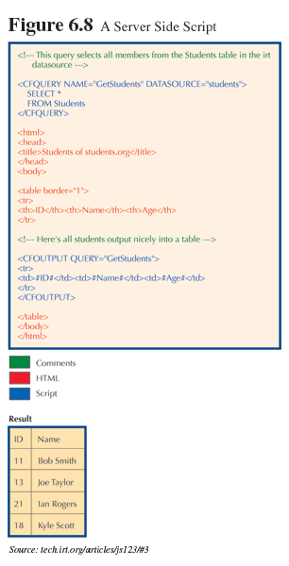
Copyright © 2005 Prentice Hall, Inc.
6-<number>

Slide 20
Searching the WWW
Most data on the Internet is part of the WWW
Search engines – large databases that index WWW content
Building the search engine database
  Submit a site to the search engine administrator for listing
  Spiders
    Metatags
  Google
  Yahoo
Copyright © 2005 Prentice Hall, Inc.
6-<number>

Slide 21
Internet Governance
Internet Engineering Task Force (IETF)
  Works in groups to develop standards
Internet Engineering Steering Group (IESG)
  Approves or disapproves standards developed by the IETF
Internet Architecture Board (IAB)
  The oversight authority for the standards development process
World Wide Web Consortium (W3C)
  Promotes the WWW and develops new web technologies and standards
Copyright © 2005 Prentice Hall, Inc.
6-<number>

Slide 22
Intranets and Extranets
Intranet
  Internal company network that uses Internet and WWW technologies.
  Flexible
  Cost efficient
  Uses
    Find and share documents
    Collaborate
    Communicate
  Only authorized users
    Secured by firewall
Extranet
  Web site that allows customers and business partners limited access to organizational intranet
  Uses Internet and WWW technologies
  Add additional security through the use of a Virtual Private Network (VPN)
Copyright © 2005 Prentice Hall, Inc.
6-<number>

Slide 23
Impact of Internet and WWW
Meredith – The Internet makes The Bead Bar a global company and expands market.
Leda and Miriam– Use Web site to improve brand image and to create franchisee web sites.
Mitch – Search for information on cruise industry and opportunities to leverage the Bead Bar.
Julia – Pleased with low cost of Web site and reduced costs to connect headquarters with franchise locations.
Rachel – Intranet will offer opportunity to reengineer purchasing procedures.
Jim – Develop policies for employee training and also for appropriate use for business purposes.
Copyright © 2005 Prentice Hall, Inc.
6-<number>

Slide 24
Learning Goals Summary
In this chapter you have learned:
  The Internet’s current architecture
  To identify and describe the major Internet applications
  The structure and definition of the World Wide Web
  How Internet and World Wide Web searches work
  How the Internet is governed
  What are intranets and extranets and how companies use them
Copyright © 2005 Prentice Hall, Inc.
6-<number>

